Slide 1
Difference BetweenLane-Changing Formulations

Slide 2
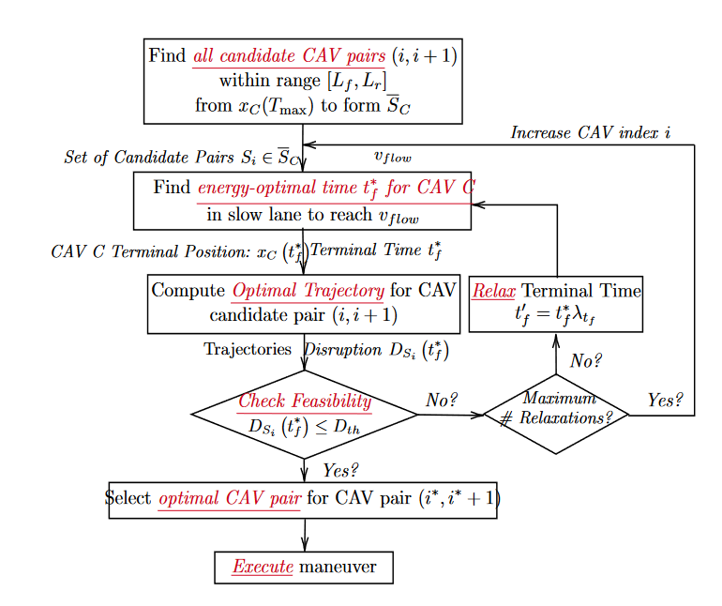
Original Flow

Slide 3
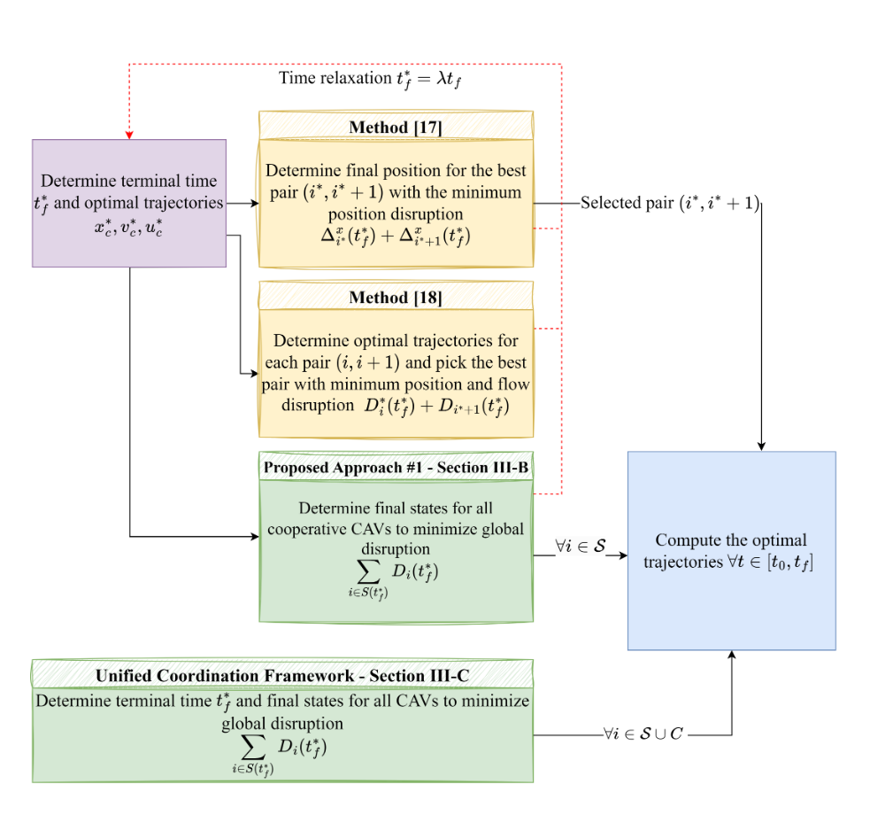
Current Flow (CAV Selection)

Slide 4
Differences
Original | New
Only considers 2 cooperating CAVs, where the rest of the vehicles only maintain speed | Every CAV in the set must reach a terminal speed and terminal position by tf
Only one accelerating vehicle and one decelerating vehicle | Can have more than just one accelerating vehicle and more than just one decelerating vehicle
CAV 1 and CAV 2 only have to reach a position ahead and behind terminal CAV C position, respectively | Every CAV has terminal position constraint as well as terminal speed constraint
No Feedback Law | OCBF

Slide 5
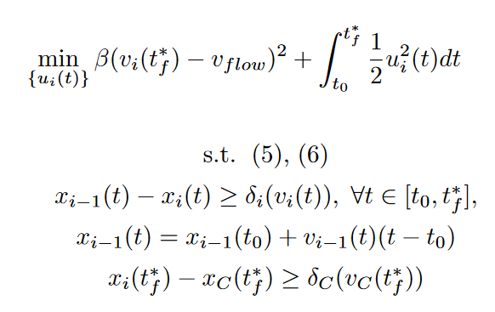
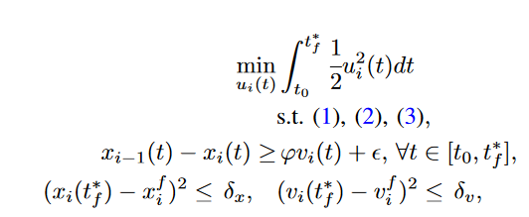
OCP Differences for CAVs in Fast Lane:
S.T. Dynamics, Physical Constraints
S.T. Dynamics, Physical Constraints

Slide 6
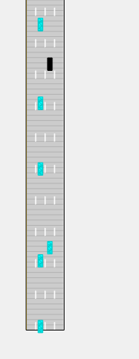
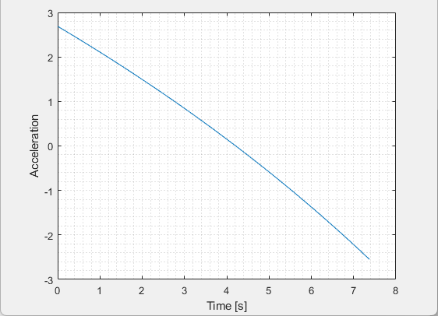
Given a System of the form
1
U
2
3
C
4
5
OCP

Slide 7
Given a System of the form
1
U
2
3
C
4
5
OCP

Slide 8
From Chen, Rui, et al 2020

